Slide 1
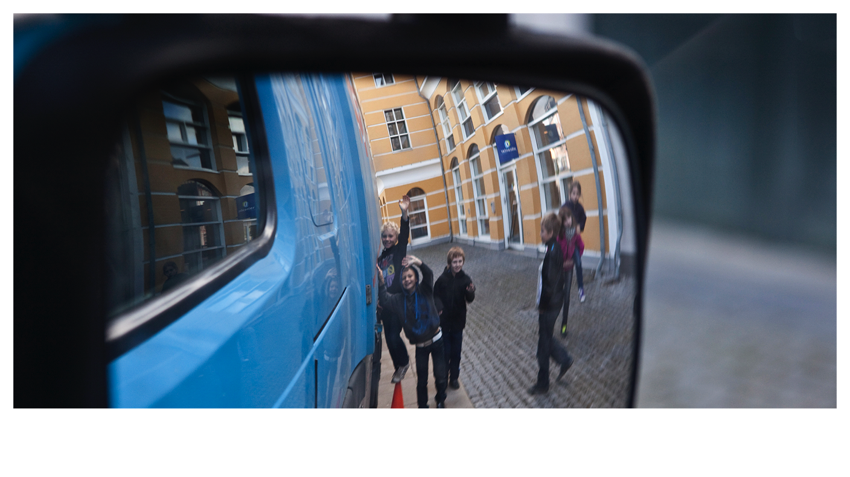
STOP, LOOK, WAVE
Notes:
Background information
Each year, well over 1.2 million people die in traffic accidents and commercial vehicles are involved in 10% of these. That equals more than 3,400 deaths per day. Moreover, the World Health Organization (WHO) estimates that, if nothing is done, the number will increase by 45% within 15 years.
Safety our core value
Volvo has been focusing on safety since the company was created in 1927. Our safety vision is Zero Accidents. The company’s safety work ranges from conducting traffic research to developing pioneering safety features for our products to keep the driver and other road users safe. But we want to do more than that. And for this, we need your help.
Stop, Look, Wave
One of the projects where we aim to make a real difference in traffic safety is about helping children understand how to act safely around trucks, buses, cars, etc… We are truly committed to explain the concept of Stop, Look, Wave to as many children as we can. This message can make a life-saving difference. How many children can you reach and talk to about Stop, Look, Wave?
How to use the material
Use the following slides to create a dialogue with children. Repeat and explain the main messages. Of course, you don’t have to follow the script word for word.
Should you wish to promote and help organize a full blown training activity in a school – with the help of a teacher – in a youth group or in collaboration with local or regional government institutions, a comprehensive kit with several components is also available. For more information, please talk to your CSR or Communication Manager.

Slide 2
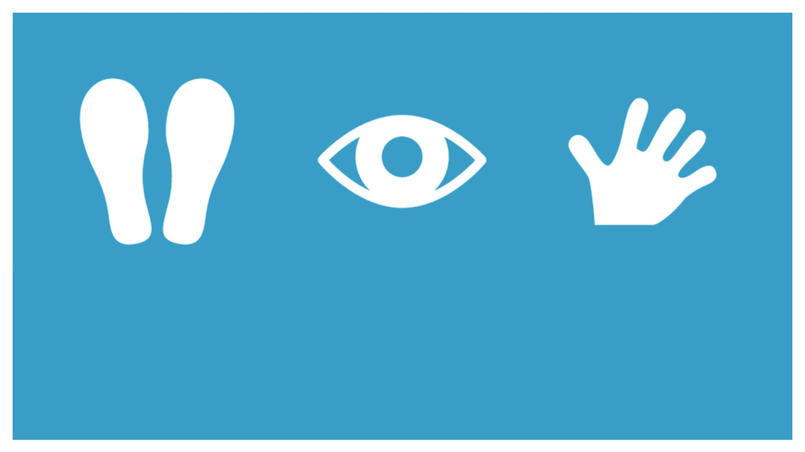
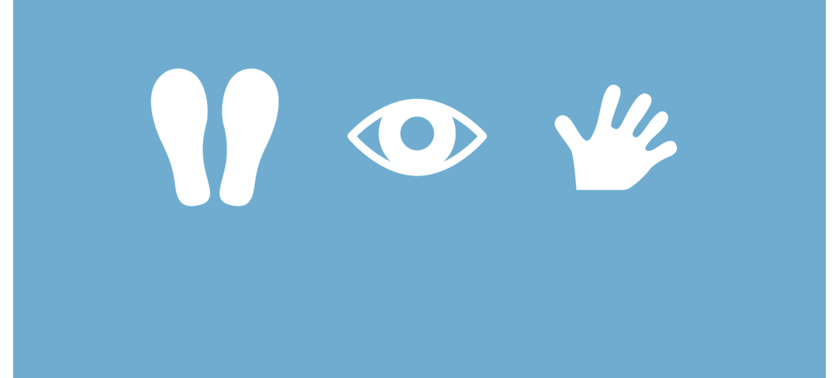
STOP
LOOK
WAVE
Notes:
Create a dialogue, using questions like:
Have you heard about Stop, Look, Wave before?
Do you know what it is?
If you picture a cross roads, what kind of vehicles do you think of?
Explain that:
These three words Stop, Look, Wave are magical words in traffic. Today we will go through what they mean and why they are so important.
But before we go through Stop, Look and Wave, have you ever thought about the bigger vehicles on the streets and why they are there?

Slide 3
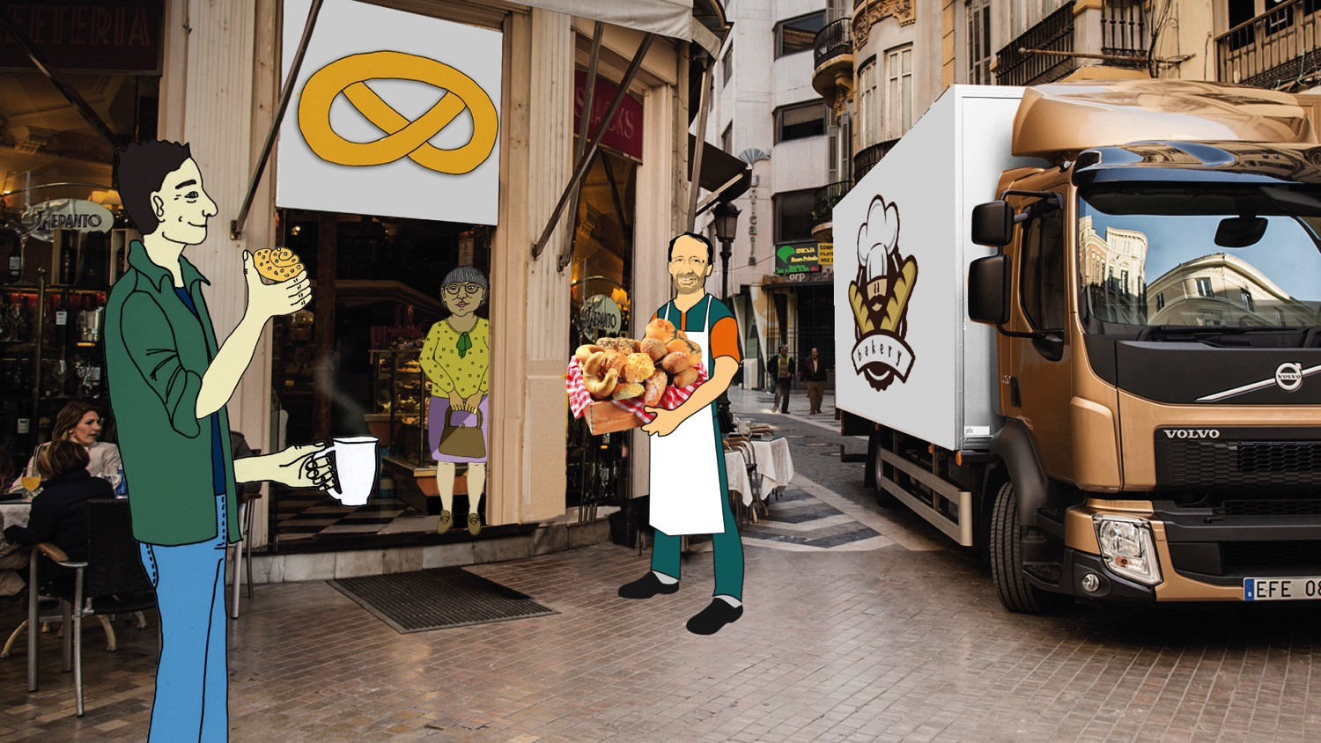
Notes:
Create a dialogue, using questions like:
Have you ever thought about why we have trucks?
What functions do the trucks have?
What different kinds of trucks can you think of?
How would we manage if we didn’t have trucks?
Why do we have buses? What would it be like without buses?
Explain that:
Many trucks are used to deliver things from one place to another. Here, we see a truck delivering bread from the bakery to a café. Trucks also deliver almost everything you use in your home – furniture, toys, food, cars and even the bricks and wood that built your house.
Other trucks you might recognise are fire trucks, recycling trucks or timber trucks.
We need trucks in order for our world to work. If we didn’t have trucks, our rubbish would not be collected, fires would not be put out and food wouldn’t be delivered to grocery stores, shops, restaurants or cafés.
We also need to have buses since they are a very efficient way of transporting many people at the same time.

Slide 4
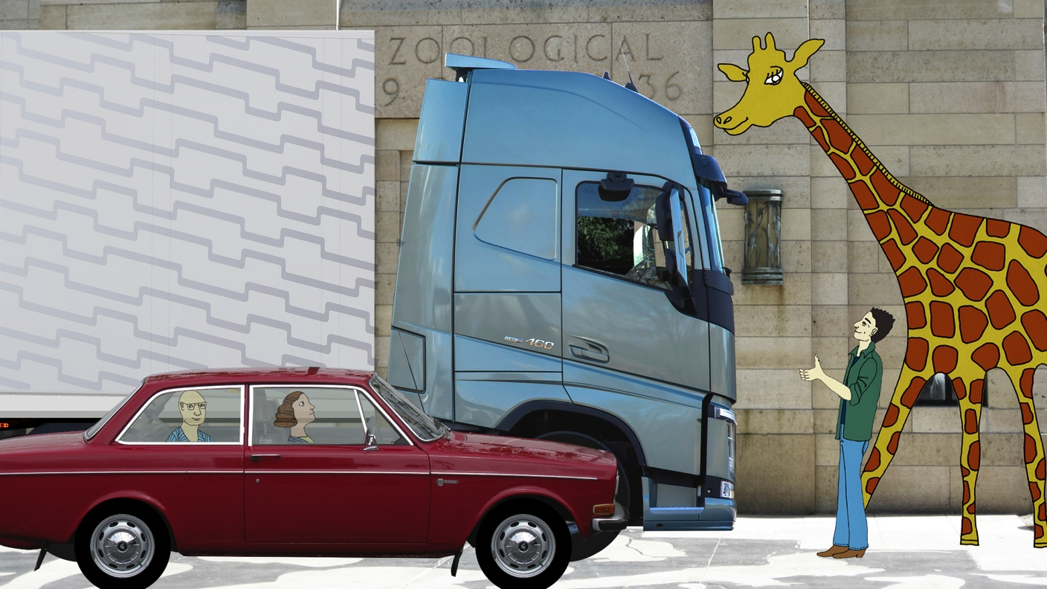
Notes:
Create a dialogue, using questions like:
Have you ever thought of how big a truck is?
Are all trucks the same size?
Explain that:
Trucks and buses vary in size depending on what they're used for.
A refuse or recycling truck is quite small as it has to drive through towns and on city streets picking up rubbish. It has different compartments for different types of rubbish – such as paper, plastic, metal and glass. To fit as much as possible, the rubbish is compressed before being taken to the recycling station.
The largest and longest trucks are called articulated or trailer trucks, as they carry a load in the trailer. They usually carry large loads over long distances on motorways, for example they transport fruit from Spain to Sweden.
This trailer truck is four and a half metres high and 16.5 meters long with the trailer attached. That's about as tall as a lady giraffe and even longer than 3-4 ordinary cars!

Slide 5
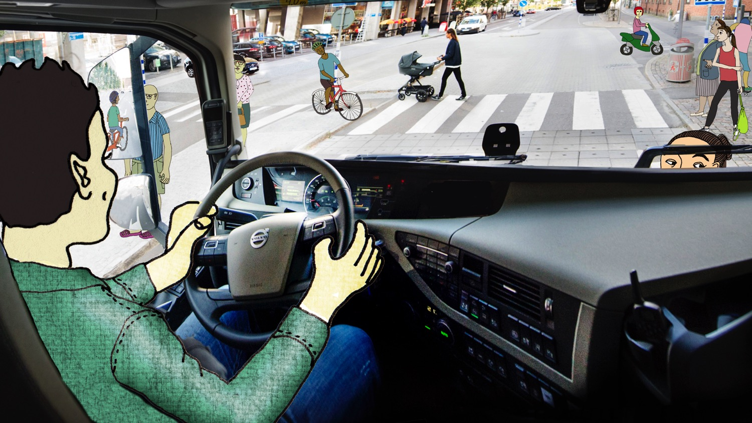
Notes:
Create a dialogue, using questions like:
How do you think it feels to sit in a truck that is that big?
How many people do you see in the picture? Do you think it was difficult to see them all?
In traffic, what can you do make sure the driver sees you?
Explain that:
It might be difficult to see what's around the truck or a bus. This is because the vehicle is big and – for a truck – the driver is sitting up so high.
The driver must lean over to the front and to the sides to make sure he sees everything. He also uses the mirrors to see what is behind him, beside him and close in front of him.
Even though we can see the truck, we cannot be sure that the truck driver sees us.
Therefore, it is important to always seek eye contact with the driver so you know for sure that he or she sees you.

Slide 6
Notes:
Create a dialogue, using questions like:
Since the driver is sitting so high up in such a big vehicle, do you think it is possible for the driver to see all the bikes in the picture?
Which of these bikes do you think are hardest to see from inside the truck? Which of these bikes do you think have the safest position?
Explain that:
When cycling in traffic, it is especially important to remember that truck drivers may not see you.
The driver must lean over and use the mirrors to see all the bikes in the picture. The most difficult bikes to see are the three bikes in front. The green bike at the right side of the truck can also be difficult to spot for the driver. The safest bikes are the ones further back.

Slide 7
Situation med cykel
Notes:
Create a dialogue, using questions like:
Have you ever seen a truck turn in an intersection? How did it look?
Do you know how to stay safe when cycling beside a truck?
Explain that:
Right-hand traffic The most common accident between cyclists and trucks is when the truck is about to turn right as in this situation. In this case, there is a risk that the driver does not see you, which could lead to a serious accident.
Trucks and buses have a wider turning radius than cars. They cannot make a right turn from the right curb, which means they will move straight into the intersection before starting to turn. So, if you are beside or behind a truck or a bus, it may look like it is moving straight ahead, while it is actually preparing to turn.
Left-hand traffic The most common accident between cyclists and trucks is when the truck is about to turn left, this image shows what this turn looks like in right-hand traffic. In this case, there is a risk that the driver does not see you, which could lead to a serious accident.
Trucks and buses have a wider turning radius than cars. They cannot make a left turn from the left curb, which means they will move straight into the intersection before starting to turn. So, if you are beside or behind a truck or a bus, it may look like it is moving straight ahead, while it is actually preparing to turn.
To get a hint of the direction the vehicle is driving, you can look at the indicators. If they are blinking, the vehicle is about to turn. But the driver might have forgotten to turn on the indicators. So, to be on the safe side, you should always stop at intersections, not too close to the bicycle crossing (and always behind the trailer, as you can see in the picture). Before you move on, wait until the truck (or bus) has passed.

Slide 8
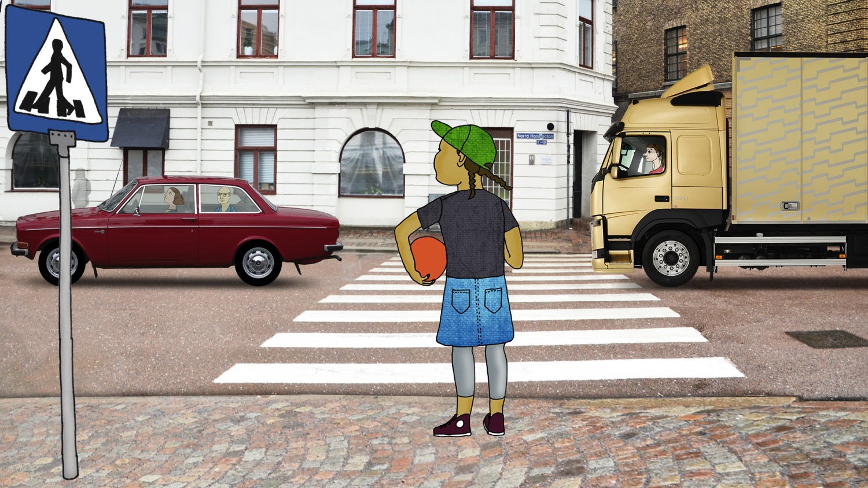
Notes:
Create a dialogue, using questions like:
If you are walking, do you know where you should cross the road?
What’s the first thing you do when you come to the road?
Explain that:
If you are about to cross a road, you should always use a pelican crossing or a zebra crosswalk.
Before you cross the road make sure to STOP completely.
Explain that STOP is the first magical word to remember.

Slide 9
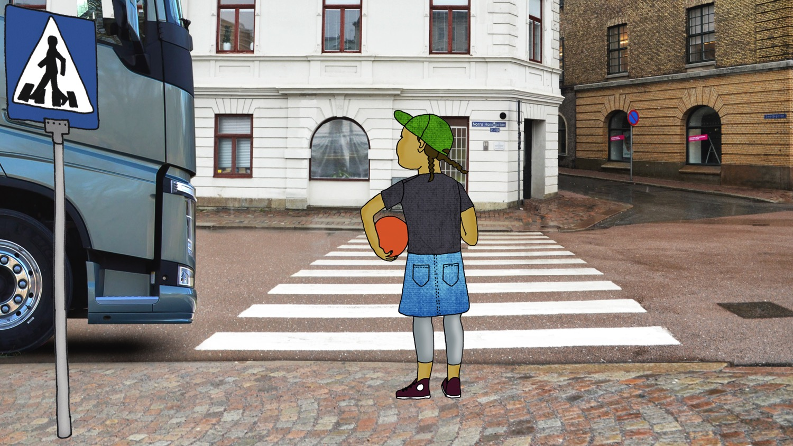
Notes:
Create a dialogue, using questions like:
When you have stopped, what is the next thing you should do?
In which direction should you look before you cross over?
Explain that:
Before crossing it is important to LOOK around carefully.
Right-hand traffic: You should first look left, then right, and then left again. And please remember, never enter the road if a vehicle is approaching.
Left-hand traffic: You should first look right, then left, and then right again. And please remember, never enter the road if a vehicle is approaching.
If a vehicle stops. Seek eye-contact with the driver.

Slide 10
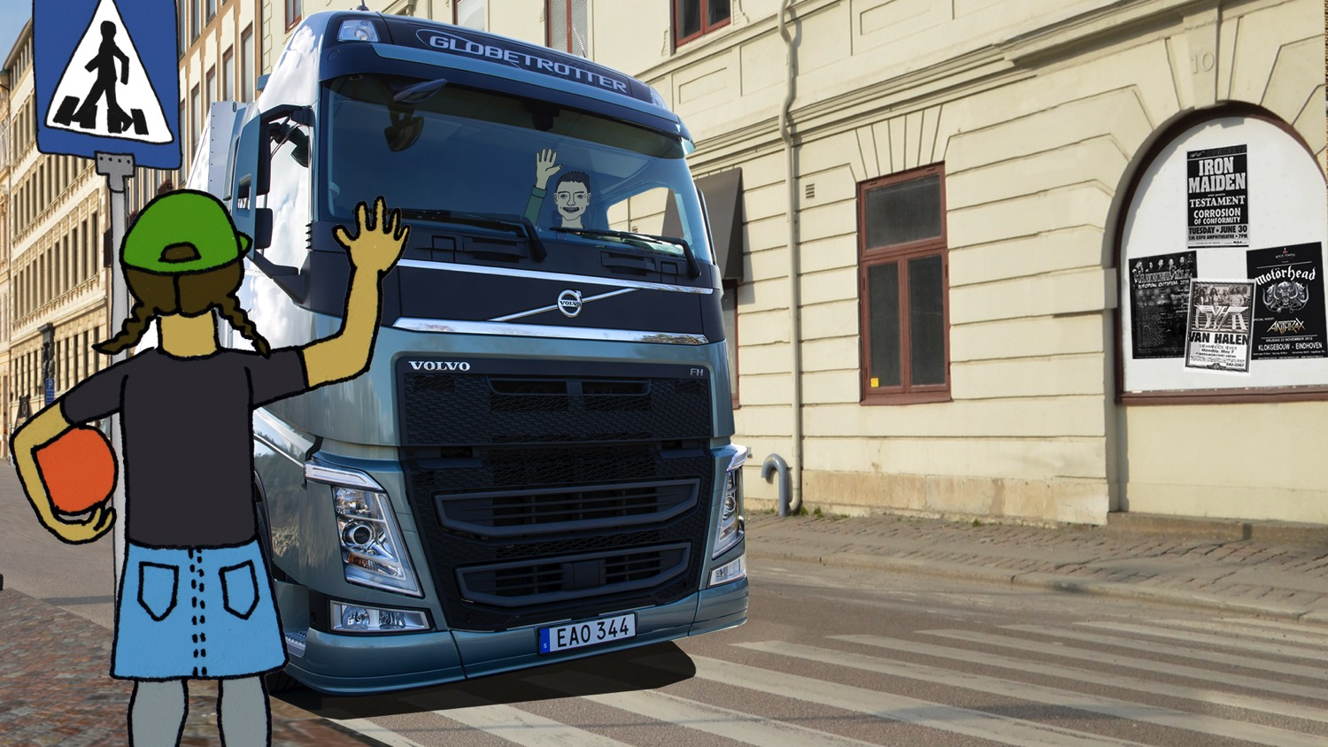
Notes:
Create a dialogue, using questions like:
How do you know that the driver has seen you?
What can you do to make sure that the driver has seen you?
Is it enough that YOU wave?
Explain that:
As said before, the truck driver might have a difficult time seeing everything around the truck or bus. So even if it is easy for us to see the vehicle, we cannot be sure that the driver has seen us.
To keep a serious accident from happening, it is important to always seek eye contact with the driver so you know for sure that he or she sees you.
To make sure you have gained the driver’s attention, WAVE and wait for the driver to wave back. Now you can cross the street.

Slide 11
STOP
LOOK
WAVE
Notes:
Make sure that the children have understood the main message, using questions like:
Do you remember what Stop, Look, and Wave mean?
When should you use Stop, Look, Wave?
Have you tried it already?
Why should you use Stop, Look, Wave?
Summarise:
We have now gone through the magical words Stop, Look, Wave.
Before you cross the road make sure to STOP completely.
Right-hand traffic: Before crossing it is important to LOOK around carefully. First look left, then right, and then left again. Seek eye-contact with the driver.
Left-hand traffic: Before crossing it is important to LOOK around carefully. First look right, then left, and then right again. Seek eye-contact with the driver.
To make sure you have gained the driver’s attention WAVE and wait for the driver to wave back. The reason why you always have to wave and wait for a wave back, is that we cannot be sure that the driver has seen you, although you have seen the vehicle. Remember?
Always Stop, Look and Wave before crossing a street to prevent an accident.

